Slide 1
Gating Code Commits
Approaches Taken by Two Large Scale Open Source Projects
Clark Boylan Jack Morgan

Slide 2
Background

Slide 3
Gating Code Commits
Allow code changes to merge only after they pass necessary criteria, typically automated testing.
“The not Rocket Science Rule of Software Engineering: automatically maintain a repository of code that always passes all the tests.” - Graydon Hoare

Slide 4
Why?
Catch issues as early as possible. Before they merge.
Aid code reviews.
Create a culture of testing.
Enable continuous delivery/deployment.
Merge a lot of code.
OpenStack Zuul merged ~1700 commits last week.

Slide 5
Challenges

Slide 6
Resources
Ability to merge changes directly related to availability of resources to run automated tests.
Human cost of maintaining these resources and making them available.

Slide 7
Execution Time
Time it takes to run test suite is lower bound for time to merge a change.
Result accuracy requires serialization of changes.

Slide 8
Reliability
Tests that do not pass reliably will prevent code from merging.
Often impacts unrelated code changes.
Tests that fail only 1% of the time can quickly add up.

Slide 9
Detour
Bugs still exist.
Melanie Witt did excellent regression analysis for Nova Rocky Release
8 regressions identified and fixed prior to release
2 regressions should’ve been caught by gate tests (tests were buggy).
2 regressions are difficult/impossible to test given current resources.
Remainder lacked coverage and should be tested in the future.

Slide 10
Security
Tests may be run for changes before they are fully vetted.
Run in isolation to guard against attack.

Slide 11
Perceptions
Gating is a powerful tool and not a roadblock.
Improve throughput through regulation.

Slide 12
OpenStack & OPNFV Approaches

Slide 13
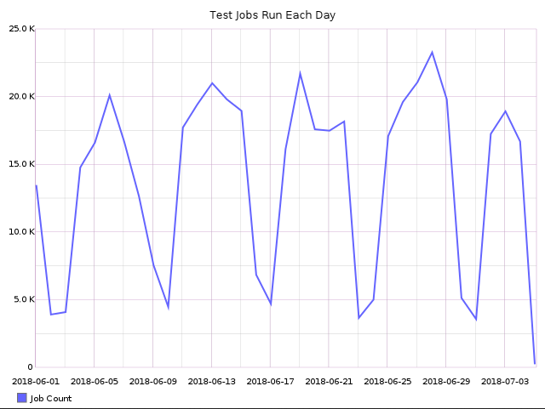
Nodepool

Slide 14
Community Test Labs
Enable interested parties to supply the necessary test resources.
Support testing of specific hardware or specific architectural designs.
Scales well as experts can remain tied to their tooling.

Slide 15
Zuul
Continuous Integration System
Cross Project Integration Engine for Gating many Code Bases
Maintains correctness through parallelized testing and speculative future states.

Slide 16
Zuul in Action
A
B
B
C
B
C

Slide 17
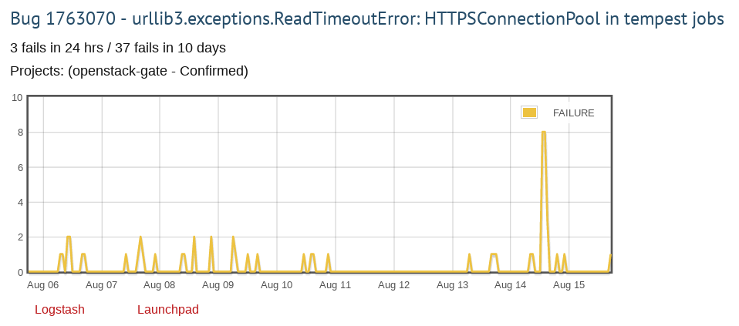
Bug Tracking

Slide 18
Tiers of Testing
Weed out problems as early as possible.
Enable expensive, comprehensive testing on changes that pass early checks.

Slide 19
Working Together
OpenStack, OPNFV, Linux Foundation, CNCF, Ansible, OpenDaylight and others.
Meet regularly to discuss common solutions to common problems.
Build interfaces between testing system to track testing of software as that software moves across organizations.
Join us: https://openci.io

Slide 20
Run Your Own

Slide 21
GitHub and TravisCI
Get bootstrapped quickly.
Many are familiar with the tools.
Free (as in Beer).
Constrained test environments and potential for build backlogs.
https://docs.travis-ci.com/user/getting-started/
https://help.github.com/articles/about-protected-branches/
https://help.github.com/articles/about-required-status-checks/

Slide 22
Reuse Existing Jenkins
You probably already have a Jenkins.
Replace TravisCI in the previous example with Jenkins GitHub Plugin.
Local control of test environments.
https://www.cloudbees.com/blog/better-integration-between-jenkins-and-github-github-jenkins-plugin

Slide 23
Zuul
Understands Gating
Scales Horizontally
Familiar configuration language: Ansible.
Test the future across many repositories.
https://zuul-ci.org/docs/zuul/admin/zuul-from-scratch.html

Slide 24
Thank you

Slide 25
Questions?

